Slide 1
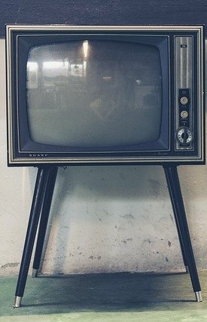
LECTURE SIX: Monochrome transmitter and receiver
ET 8105 – Television Systems

Slide 2
Introduction
Monochrome TV system does not process variations of colour in a picture but processes only the intensity of brightness of each pixel (as seen by the eye) for transmission in space.
The picture is the monochrome picture tube in a receiver.

Slide 3
MONOCHROME TV TRANSMITTER

Slide 4
Monochrome TV Tranmitter
The main essential blocks of a radio transmitter are a radio frequency carrier generator, baseband signal transducer and a modulator.
A radio frequency carrier, of the desired power and required frequency is generated and is modulated by the duly amplified baseband signal.
As a TV programme consists of two basebands (light and sound), signals pertaining to both modulate separate carriers, which are transmitted through a common antenna.
The basic elements of a monochrome transmission system are outlined in the next block diagram.

Slide 5
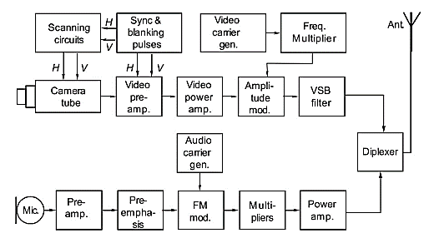
Block diagram of monochrome TV transmitter

Slide 6
Stages of Video Transmitter
Camera Tube - It converts optical image into electric charge image by using a photosensitive semiconductor target.
Scanning Circuits - The function of scanning is to convert the charge image into video signal, varying with time, to make it suitable for radio transmission.
Blanking and Sync Pulses - The linear ramp of sawtooth signals provides sweep or trace of the respective scanning process and the falling edge (called flyback) provides retrace.
The retraces will distort the video signal and therefore these are blanked by cutting off the beam, using appropriate blanking pulses.

Slide 7
Video Pre-amplifier and Power Amplifier – They are wideband amplifiers in cascade. Amplifying signal from a few Hz to 5 MHz.
Composite video signal (CVS) is first amplified by the video pre-amplifier and finally by the power amplifier to give sufficient power required for amplitude modulation
RF Oscillator - A broadcast transmitter transmits at one allotted frequency (called its channel frequency).
The transmitted frequency should not drift and hence a crystal oscillator is used which produces highly stable frequency which is a sub-multiple of the actual allotted frequency.
Frequency Multiplier - The crystal oscillator cannot directly produce VHF or UHF range frequencies.
Frequency multipliers are used to get the desired channel frequency (called video carrier). As the power level of RF carrier has to be high for TV broadcast systems, amplification stages are added to get the required level

Slide 8
Video Modulator – It is an amplitude modulator
It receives amplified video signal and RF carrier. It’s a non-linear amplifier which changes the amplitude of the RF carrier in accordance with the amplitude of the video signal.
As the video signal is of negative polarity, the AM modulation achieved is called negative modulation.
Vestigial Sideband (VSB) Filter – The modulator’s output is of double sideband type, which is converted into VSB by a sharp filter.
The filter is so designed that it passes the carrier and the upper sideband (i.e. carrier frequency +5 MHz) in full without attenuation.
The lower sideband is produced up to 0.75 MHz below the carrier frequency; thereafter it is sharply attenuated.
The signal so achieved is called AMVSB signal.

Slide 9
Stages of Audio Transmitter
Microphone - It converts sound pressure variations into electrical signals, called audio signals.
Most widely used microphone in TV studios is dynamic microphone which uses the principle of electromagnetic induction for converting sound pressure variations into electrical signals.
Audio Pre-amplifier – It is a class-A type voltage amplifier (RC coupled) which amplifies the weak output of the microphone.
Pre-emphasis Circuit – it emphasizes the low energy of the high audio frequencies
The pre-emphasis enhances the frequency deviation, which results in high signal to noise ratio in FM systems.

Slide 10
RF Carrier Generator for Audio - It uses a crystal oscillator which is highly stable due to its Q being very high.
It generates low radio frequency. Frequency modulation is used for audio signals
FM Modulator – Low level modulation is used before the final power amplifier to save on the audio power requirement.
As a crystal is used to generate carrier frequency, direct frequency modulation is not suitable because it would be difficult to vary the frequency of a crystal, thus indirect FM method is used.
Frequency Multipliers – The final frequency in VHF or UHF band allotted for transmission, is obtained by using multipliers and mixers.
The final carrier frequency of the audio modulated FM wave is higher than the video carrier frequency by 5.5 MHz.

Slide 11
Power Amplifier for FM Signals - The power of the frequency modulated signal is finally amplified to the extent required for transmission.
This power is usually 1/5 of the power required for video AM signal.
Diplexer - It is a wheatstone bridge, the two arms of which consist of two dipoles and the remaining two arms use reactive components (either capacitors or inductors).
Audio modulated FM signal is fed across one diagonal of the bridge and video modulated AMVSB signal to the other diagonal.
This technique prevents audio section signal (FM) from going to the video section stages and vice versa.
Transmitting Antenna - It consists of two dipoles perpendicular to each other and its directivity pattern is such that the radiation is omnidirectional in a horizontal plane.

Slide 12
MONOCHROME TV RECEIVER

Slide 13
Introduction
Modulated TV signals, radiated out in space from the transmitting antenna are picked up by the receiving antenna at the receiving site.
There, these signals are processed and the baseband signals are detected.
The detected signals are amplified and finally converted into the original information picture and sound by the transducers, picture tube and loudspeaker, respectively.

Slide 14
Elements of a Monochrome TV Receiver
Elements of a monochrome TV receiver are illustrated in the block diagram given in the next slide.
Description of functions of each block (section-wise) of the TV receiver follows.

Slide 15
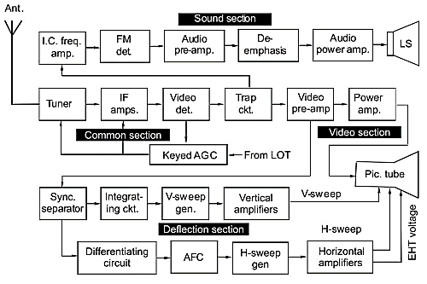
Block diagram of a monochrome TV receiver

Slide 16
Common Section
Blocks from the receiving antenna to the trap circuit comprise common section as these blocks handle both video modulated and audio modulated signals.
Functions of these blocks are mentioned below.
Receiving Antenna - It picks up signal from the electromagnetic waves travelling through space and feeds the same to the tuner in the receiver.
The receiving antenna is generally a folded dipole (300 ohm impedance) with a reflector and one or more directors.
This type of antenna is called Yagi-Uda antenna.

Slide 17
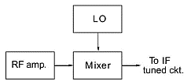
Tuner – It consists of an RF amplifier, a local oscillator and a mixer.
RF Ampliﬁer – It is generally a common base circuit as the common base configuration gives high signal to noise ratio in VHF bands and has low input impedance which can match with the impedance of the receiving antenna.
Provide a gain of about 20 dB to the selected RF signal and rejects the image frequency interference by 60 dB or more.
Stages of a TV tuner

Slide 18
Local Oscillator - It provides RF of constant amplitude and constant frequency for the channel selected for reception.
For high stability, the local oscillator uses synthesised tuning based on the technique of phase locked loop.
This uses very high stability of a crystal and variable frequency oscillator type capability to change channels to receive different programmes.
Mixer – It receives two signals, one is the channel frequency signal from the RF amplifier, and the other is the local oscillator frequency signal.
The mixer produces the intermediate frequency (IF) frequency, pertaining to the difference of the two frequencies.
The other product of the mixer is the sum of two frequencies or their harmonics, which are all rejected by the IF tuned circuit.
Only the IF signal (f_{o} – f_{s}) passes to the next IF amplifier stage

Slide 19
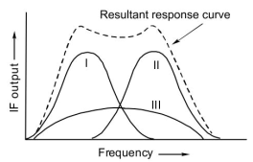
IF Amplifier – It amplifies the signals (for video as well as for audio)
As IF is much lower than the signal frequency and is fixed, the IF amplifier has high stable gain and high selectivity.
AM video IF and FM audio IF signals require wide bandwidth for reproducing all important sidebands.
A single tuned circuit would have a narrow passband, hence several IF tuned circuits (usually three)are employed which use the staggering tuning.
Staggered tuning of IF tuned circuits

Slide 20
Video Detector – It is an envelope detector using a diode, which by process of rectification and filtering, detects the baseband signal of CVS and frequency modulated intercarrier frequency (5.5 MHz).
The standard output of video detector is 1V peak to peak.
Automatic Gain Control - The function of AGC is to control the gain of RF and IF amplifiers to reduce the difference between outputs for strong and weak incoming signals to maintain a fairly constant output level.
Trap Circuit - It is a resonant circuit, so used as to prevent the frequency modulated intercarrier frequency (also called second IF or sound IF or simply SIF) from going to the video amplifier.
It also prevents video signals (up to 5 MHz) from going to the sound section.
Thus it checks the cross-interference between video and sound

Slide 21
Video Section
This section consists of video amplifiers and picture tube whose functions are mentioned hereafter
Video Amplifiers – Video pre-amplifier and power amplifier are used in cascade to provide a wideband amplifier system to respond to the wideband from quite low frequency signals (a few Hz) to 5 MHz.
Video pre-amplifier is a high impedance buffer between detector and power amplifier.
Its output impedance also matches the low impedance of the power amplifier.
Output of the power amplifier should be sufficiently high so as to drive the phosphor elements of the picture tube to glow.
Gain of video amplifier varies from 30 dB to 46 dB depending on the size of the picture tube.

Slide 22
Picture Tube – Its function is to convert video signals into picture.
Output of the video amplifier is fed to the control grid of the electron gun.
Strength of the electron beam is proportional to the video signal.
When this beam strikes the phosphor elements on the fluorescent screen in quick succession fro left to right and top to bottom, the picture is reproduced on the rectangular glow (raster) of width to height ratio of 4:3 in traditional and 16:9 in modern high definition receivers.
To produce distortion-free picture, scanning at the picture tube is fully synchronized with the scanning at the transmitter by using sync pulses which were received along with the video signal.

Slide 23
Deflection Section
This section consists of stages responsible for horizontal and vertical deflection of the scanning beams.
Functions of these stages are described hereafter.
Sync Separator – Signal extracted from the video detector (or from the video pre-amplifier) goes to a sync separator stage.
This stage responds to the peaks of the CVS and therefore separates out the sync pulses.
The H-sync and V-sync pulses are further separated from each other by using differentiating and integrating circuits

Slide 24
Vertical Sweep Generator – The V-sync pulse triggers the V-sweep generator so that it starts at the right time, i.e. at the same time at which V-sweep started in the transmitter.
Its frequency is 50 Hz.
V-sweep Amplifiers – V-sweep is amplified by buffer amplifier, driver amplifier and the output power amplifier.
The output current flows through the V-deflection coils in the deflection yoke.
This current causes magnetic field which deflects the electron beam vertically from top to bottom and then retraces to the top and so on.

Slide 25
Horizontal Sweep Generator – The H-sweep frequency is timed and controlled by H-sync pulse through an automatic frequency control (AFC) circuit.
AFC is a comparator circuit which compares the H-sync frequency with the sweep generator’s frequency.
If both are equal, output of AFC is 0 V, but in case of any difference, the output varies from positive dc voltage to a negative dc voltage.
This output voltage corrects the sweep generator’s frequency and makes it identical with the H-sync pulse frequency.
H-Sweep Amplifiers – The synchronized H-sweep is amplified by buffer, driver and power amplifier stages.
The output current flows through the H-deflection coils which deflect the electron beam from left to right and back to the left on the next lower line and so on.
The frequency of H-deflection sweep current is 15,625 Hz in CCIR B system

Slide 26
H and V deflections permit scanning of the fluorescent screen in a manner identical to the scanning done at the transmitter.
Thus the signal which was converted into the signal varying with time is now reconverted into signal varying through width and height (i.e. through space) on the screen of the picture tube.
This way, the picture is reproduced on a two dimensional screen.

Slide 27
Sound Section
It consists of the stages responsible for recovering audio signals from the audio modulated FM signal.
Functions of these stages are mentioned below.
Intercarrier Frequency Ampliﬁer - It receives frequency modulated intercarrier frequency of 5.5 MHz through the trap circuit, and amplifies it.
FM Detector - It consists of a limiter and a phase shift discriminator.
It works on the principle of shift in phase when the input frequency changes with respect to the resonant frequency of a resonant circuit.
As the phase shift discriminator can detect amplitude modulation also it is necessary to use a limiter stage.

Slide 28
Audio Voltage Amplifier – Audio signal is amplified by RC coupled audio voltage amplifier (Class A-type).
De-emphasis – The audio signal undergoes de-emphasis for high audio frequencies.
For high signal to noise ratio, high audio frequencies were emphasised in the transmitter.
When they are de-emphasised in the receiver, noise will also be de-emphasised, so the signal to noise ratio will continue to remain high.
De-emphasis is essential to have relative proportions of amplitude for the full audio range as they were in the original sound.

Slide 29
Audio Power Amplifier – This is the final amplifier in audio section which gives sufficient power output to drive the loudspeaker system of the TV receiver.
Generally it is the push-pull type.
Loudspeaker - It converts audio signal into sound waves to reproduce the original sound.
The voice-coil, carrying audio current, is placed in the field of a permanent magnet, it experiences a force that makes it vibrate.
A paper cone attached to the coil also vibrates and produces pressure variations in the air.

Slide 30
Controls in a TV Receiver
Controls in a TV receiver are provided to improve the vision and sound to the desired level.
There are two types of controls:
1. Front panel controls which are handled by the user himself.
2. Controls on the chassis which are used by the trained technicians while checking the performance
These controls are shown in the next figure, with their description following.

Slide 31
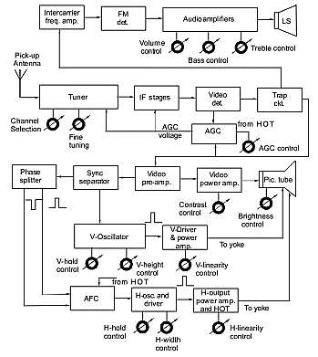
Controls in a monochrome TV receiver

Slide 32
Sound Controls
Volume Control – Is a potentiometer in the audio voltage amplifier which adjusts the audio signal to the wanted level
Bass Control – It’s another potentiometer in the audio voltage amplifier which is used to boost or cut bass (low audio frequencies)
Treble Control - It’s another potentiometer in the audio voltage amplifier which is used to boost or cut treble (high audio frequencies)

Slide 33
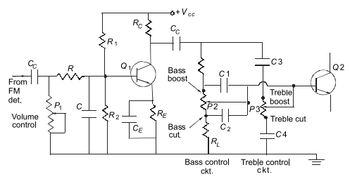
Audio Voltage Amplifier with Controls

Slide 34
Other Controls in a TV Receiver
On-oﬀ Switch – It is an on-off control on the front panel to turn the receiver on or off.
Contrast Control – It adjusts the contrast in the video amplifier, controlling its gain. Higher gain gives whiter picture and hence increases the contrast.
Brightness Control - It adjusts the brightness on the screen by adjusting dc voltage on the control grid with respect to the cathode. Greater the voltage, greater would be the brightness.
Fine Tuning - This optimises the tuning of local oscillator frequency so that correct IF signal is produced for audio and video carrier.

Slide 35
Channel Selection – It selects the desired channel. Modern receivers use synthesized tuning in which the desired channel can be selected by adjusting programmable dividers through push button switches.
CONTROLS ON CHASIS
Vertical Hold Control - It is located in the V-oscillator and changes its frequency to stop vertical rolling of the picture.
Vertical Height Control - It is also located in the V-oscillator and determines the peak value of ramp voltage by charging the capacitor through a variable resistor.
Vertical Linearity Control - It provides equal spacing between the H-scan lines. It is located in the V-deflection power amplifier.

Slide 36
H-hold Control - It is located in the H-oscillator and prevents diagonal splitting of the picture by adjusting the H-oscillator frequency when AFC is not able to correct it.
H-width Control - It is also located in the H-oscillator and controls the charging rate of the capacitor in sweep generator.
H-linearity Control - It is located in the H-deflection amplifier and ensures that picture is uniformly displayed from left to right.
Read more concerning TV controls from the following link: http://machineryequipmentonline.com/electric-equipment/audio-and-video-systems-television-controls/

Slide 37
Television Receivers Based on ICs
An integrated circuit (IC or chip) is a miniature electronic circuit consisting of semiconductor devices, resistors and small value capacitors integrated on the surface of a silicon substrate.
They are interconnected within the chip to form functional circuits like amplifiers, oscillators, detectors, AGC, AFC, electronic switches, logic gates, etc., or even complete systems.
Their advantages and limitations are as follows.

Slide 38
Advantages
Reliability of an IC is much higher as compared to the discrete components integrated on the chip.
Interconnections are very solid and fool proof and do not pose problems of a dry/cold solder joints or loose connections.
Miniature size results in the system becoming very compact.
Fault diagnosis is easy. Instead of testing signals and voltages at pins of hundreds of thousands of components, testing is done only for input and output signals and for dc voltages at a few pins of an IC only.
Cost of an IC is very low as compared to the total cost of individual active and passive components integrated on the chip.

Slide 39
Limitations
One limitations is that the following components cannot be integrated onto a chip:
Inductors and transformers
Capacitors of large values and also variable capacitors of tuned circuits
Potentiometers
Heavy duty power amplifiers and heavy duty rectifiers
Another limitations, if you call it a limitation, is that one does not feel the existence of individual stages of the system.

Slide 40
ICs in Monochrome Television Receivers and Other Video Systems
The ICs capable of performing the following functions will be required in TV receivers and other video system
An IC which may accommodate sound IF amplifier, FM detector and audio voltage amplifier
An IC which may accommodate IF amplifiers, video detector and video pre-amplifier
An IC which may include a sync separator, sawtooth signal generators for V and H deflections, V-driver, phase splitter, AFC, and H-buffer amplifier.

Slide 41
Example of the ICs in Monochrome TV Receivers
CA 3065 — It covers the complete sound section (Category 1 of the above list).
CA 3068 – It covers IF amplifiers, video detectors and video preamplifier (Category 2 of the above list)
CA 11423 - It covers sync separators, V-oscillators, V-driver, phase splitter, AFC, H-oscillator and H-buffer amplifier (Category 3 of the above list)
The block diagram of a typical TV receiver using the three ICs is shown in the next slide

Slide 42
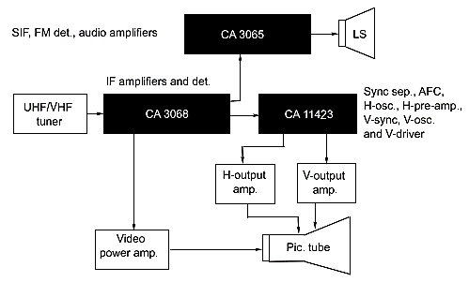
Block diagram of TV receiver based on ICs

